Slide 1
Technical Presentation
CSA1715-Artifical intelligence
Presented by:
Abishek S (192524356)

Slide 2

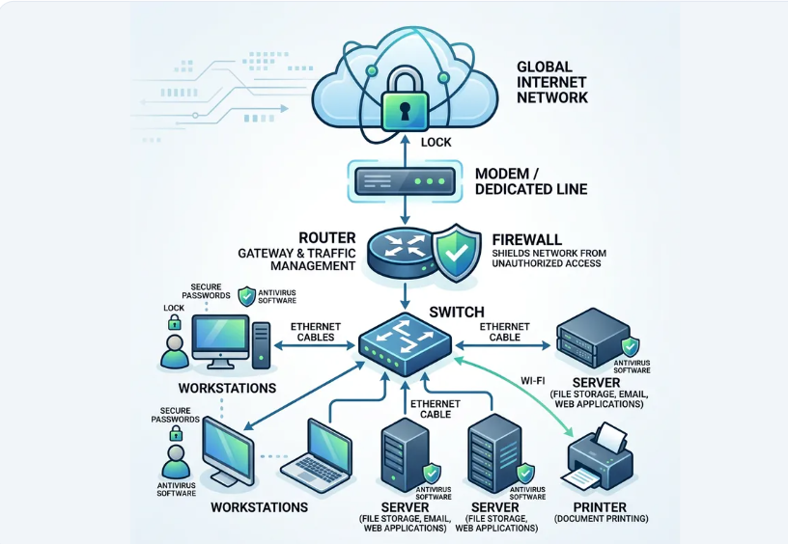

1. AI System Reverse Engineering
Target System: Enterprise LLM-based Retrieval-Augmented Generation (RAG) & Agentic Workflow Platform.
•
Analysis Objective: Uncover proprietary model orchestration, data ingestion pipelines, and security guardrails without original source code.
•
Black-Box Probing: Analyzed HTTP/gRPC traffic patterns, token latency signatures, and payload parameters.
•
Boundary Identification: Mapped clear segregation between static microservices, vector storage engines, and remote LLM runtime endpoints.
•
Artifact Collection: Extracted API client SDKs, network telemetry, and browser-side state objects.

Slide 3


1. Inferred Component Topology
Ingestion & Gateways
Inference & Storage Engine
API Gateway & Rate Limiter: Handles client authentication, request throttling, and token budget tracking.
Embedding Pipeline: Asynchronous batching service generating dense vector embeddings for input queries.
Prompt Sanitizer / Guardrail: Scans incoming text for injection attacks, PII leaks, and policy violations prior to vector search.
Vector Database Cluster: Distributed index executing similarity search with metadata filtering (e.g., HNSW index).
Orchestration Controller: State machine managing iterative tool calls, agent execution loops, and fallback triggers.
LLM Gateway & Cache: Caches semantic responses and routes prompts across local fine-tuned models and cloud APIs.

Slide 4






2. Reconstruction Methodology
1. Dynamic Tracing
2. Binary Disassembly
3. Graph Synthesis
Captured runtime interactions using eBPF probes and proxy interception (Mitmproxy) to trace API endpoints and serialization protocol buffers.
Decompiled client libraries using Ghidra and AST analysis to reveal internal data models, state objects, and client-side decision trees.
Synthesized network traces and code dependencies into a high-level microservice topology map and sequence interaction diagram.

Slide 5
2. Reconstructed Service Map
Module Name | Inferred Tech Stack | Communication Protocol | Inter-Module Dependencies
API Gateway | Envoy / Go Runtime | gRPC / HTTP2 | Guardrail Service Auth Service
Guardrail Engine | FastAPI / Python | gRPC Internal | Regex Rules Engine Classifier Model
Vector Search Core | Qdrant / Rust | gRPC / Binary | Embedding Microservice
LLM Router Engine | Node.js / LangChain derivative | REST / WebSockets | Vector Search External Provider APIs

Slide 6
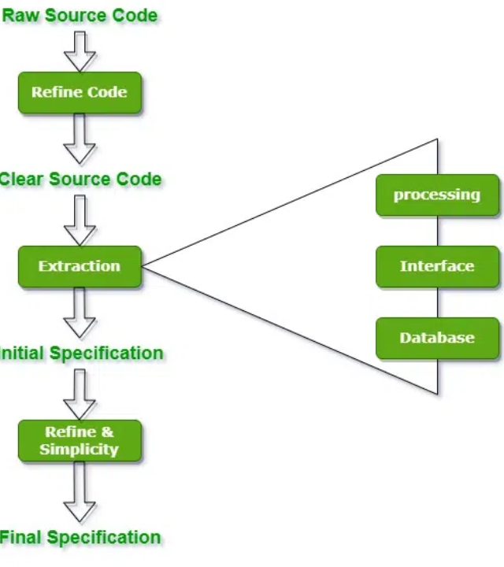
3. Heuristic & Decision Logic
Reverse-Engineered Logic
Through systematic input perturbation testing, we identified key static rules embedded before the neural reasoning step:
• Semantic Routing Thresholds: Queries with cosine distance < 0.25 trigger exact-match semantic caches, bypassing LLM generation.
• Hybrid Rank Scoring: Final document ranking combines BM25 keyword score with dense vector similarity via Reciprocal Rank Fusion (RRF).

Slide 7




3. Mathematical Model Logic
Vector Cosine Similarity
Dynamic Temperature Scaling
Identified exact normalization formula applied to embedding vectors prior to index lookup:
Identified dynamic temperature calculation based on context confidence score:
Ensures length-invariant document comparison across varying chunk sizes.
High retrieval confidence ( ) lowers temperature to reduce hallucination risk.

Slide 8




4. End-to-End Pipeline Flow
1. Ingestion
2. Retrieval
3. Assembly
4. Generation
Client sends HTTP POST payload. Gateway authenticates, rate-limits, and tokenizes query.
Query embedding generated asynchronously; vector store executes ANN search returning top-K chunks.
Re-ranker orders context. System prompt injected with retrieved text & conversation history.
Streamed token response generated via Server-Sent Events (SSE) back to web client.

Slide 9
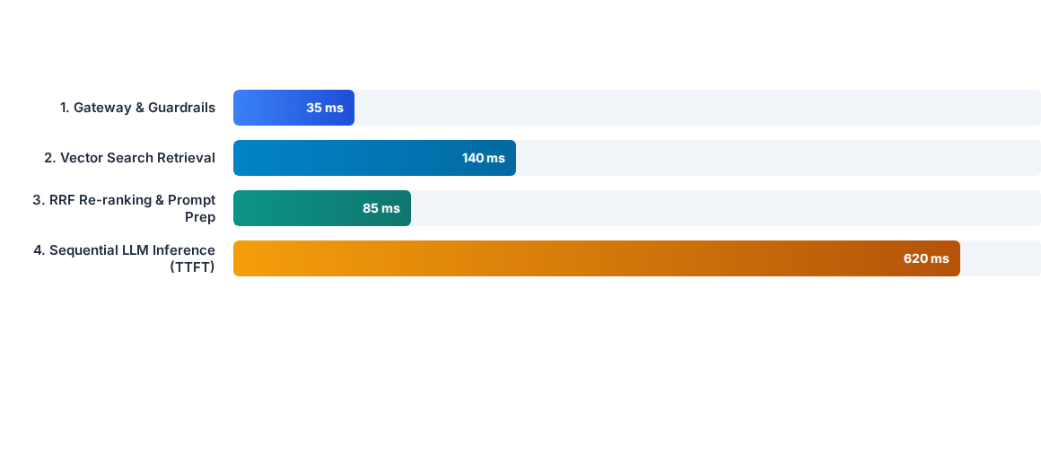
4. Ingestion Latency Benchmark
Analysis Insight: Sequential LLM First-Token Inference accounts for ~70% of end-to-end latency. Vector search and context assembly present minor secondary bottlenecks.

Slide 10


5. Bottlenecks & Failure Modes
Identified Architectural Deficiencies
Security & Compliance Risks
•
Synchronous Blocking RAG: Vector retrieval blocking execution threads, increasing Time-To-First-Token (TTFT).
•
Prompt Injection Vulnerability: Guardrail execution occurs prior to vector retrieval but misses context-injected attacks.
•
Coarse Cache Granularity: Caching occurs at full response level rather than modular sub-query prompt layers.
•
Unbounded Context Expansion: Lack of strict token clipping leads to unexpected memory spikes under heavy payload loads.
•
Single Point of Failure: Monolithic orchestration router lacks active-active failover or graceful degradation strategies.

Slide 11
5. Target Redesign Roadmap
Pillar 1: Async Retrieval
Pillar 2: Tiered Cache
Pillar 3: Dual Guardrails
Pillar 4: Service Mesh
Implement parallel spec-exec retrieval to run embedding generation and keyword search concurrently.
Deploy Redis-backed semantic chunk caching to serve frequent query sub-trees in < 10ms.
Enforce pre-retrieval input validation and post-retrieval context isolation to eliminate prompt injection.
Migrate router to zero-trust service mesh with automated traffic mirroring and auto-scaling LLM pods.

Slide 12
THANK YOU!

